Slide 1
Day 1: Intro to Chemistry

Slide 2

Who am I?
Brian Ngo
18 years old - Recently Graduated High School
Credentials: Honors and AP Chemistry
Aspiring Nurse

Slide 3
What is this class all about
This class is all about the wonders and mysteries of chemistry. ➢ Do you ever wonder why and how the stuff around us works? Did you know that chemistry is all around us, every second of everyday?!
This class will help us to try and understand and answer why and how stuff work and interact, like the soap we use to wash our hands!

Slide 4
What will this class be like?
This class will be 1 hour for each period.
We will have a quick lesson, usually accompanied with a short video. 15-20
minutes
A lab experiment or activity that helps us to visualize, understand, and
remember what we learn. 35-40 minutes
Clean up after our activities/labs when needed. 5-10 minutes
Recap! We’ll recap what we’ve learned. 5-10 minutes

Slide 5
EXPECTATIONS
In this class I expect everyone to be…
Respectful! - respect and listen when others are talking and respect other people’s ideas
Kind! - say kind words, portray kind action
Safe! - stay 6ft apart, wash your hands, use hand sanitizer, wear your masks
And most importantly, Have fun!

Slide 6
#1 Lab safety
Before we do our lab, we have to talk about safety
Safety while in the lab is very important, especially while conducting an experiment.
Video: https://youtu.be/MEIXRLcC6RA

Slide 7
#2 What is chemistry?
Chemistry is the study of matter. Ok.. but what is matter?
Matter is the stuff around you.. It is made of tiny particles called atoms and molecules
Matter is the air you breathe, the water you drink, the ground you walk on, the flowers you
smell, and the food you taste.
Any object you can see, smell, or touch is made of matter. There are also very small pieces of
matter that you can’t see or touch.

Slide 8
#3 LAB TIME: What’s the Matter?
States of Matter: Solid, Liquid, and Gas
Hypothesize what states of matter Oobleck will be
Experiment and Observe
Conclude
Cleanup

Slide 9
Day 2: Chemical reactions and changes

Slide 10
CHEMICAL CHANGES AND REACTIONS
Chemical Reactions happen when some substances are mixed together to make a whole new substances - This is called a chemical change
○ Ex. There are toys that use chemical reactions to make them go—like toy rockets that blast into the air and the Hot Wheels “Formula Fuelers” cars.
○ Ex. cooking an egg, baking, lighting a candle (combustion), even eating
Video: https://youtu.be/37pir0ej_SE

Slide 11
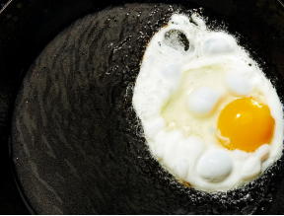
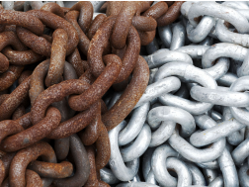
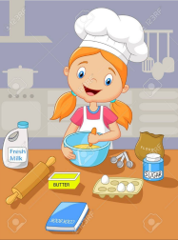
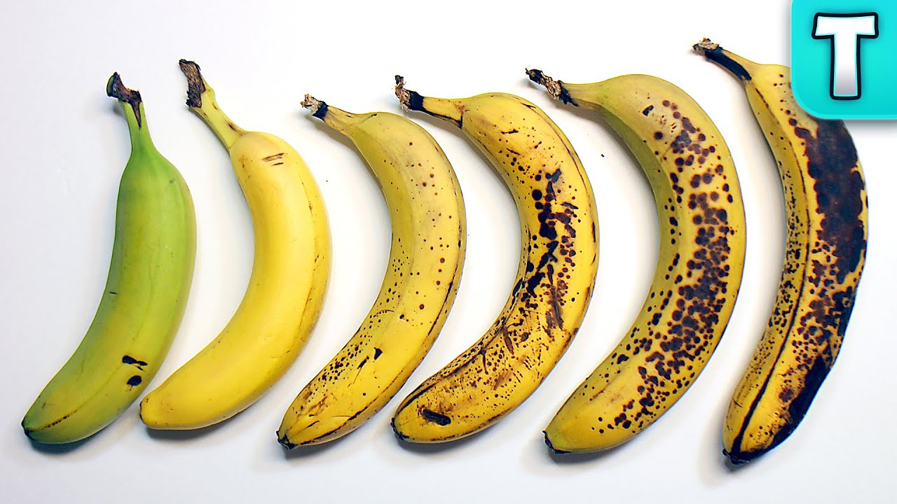
Evidence of chemical change
They can release smells, heat or light, and gases
Sometimes they have a color and temperature change
The change can’t be undone!

Slide 12
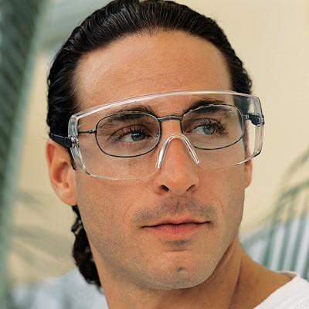
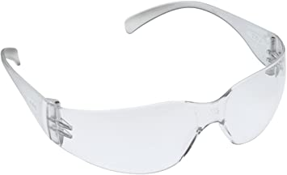
LABTIME: ELEPHANT TOOTHPASTE
Importance of PPE: The unreacted hydrogen peroxide can irritate skin and eyes.

Slide 13
RECAP
Chemical Reactions happen when some substances are mixed together to make a whole new substances - This is called a chemical change
Evidence of chemical change
They can release smells, heat or light, and gases
Sometimes they have a color and temperature change
The change can’t be undone!

Slide 14
Day 3: ATOMS, molecules, and slime

Slide 15
POLYMERS
Before we can dive into making slime, we must first learn what it is!
A polymer is a chemical compound formed from long chains of the same molecule group.
These chains repeat over and over.
Polymers can be flexible, pliable and stretchy.
They have both liquid and solid properties
What are some examples of things that are not polymers? (brick, glass, metals etc).

Slide 16
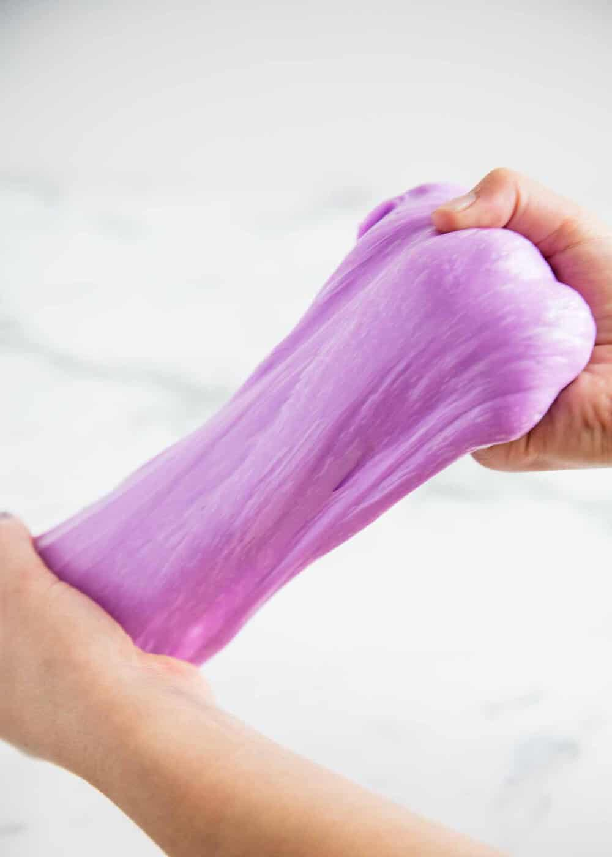
Lab time: It’s time for slime
Slime instructions: https://www.youtube.com/watch?v=eaALjlyKDZI
https://www.pbs.org/parents/crafts-and-experiments/homemade-gak

Slide 17
RECAP
What a polymer is: A polymer is a chemical compound formed from long chains of the same molecule group.
Examples of polymers: slime

Slide 18
Day 4: Particle interaction and surface tension

Slide 19
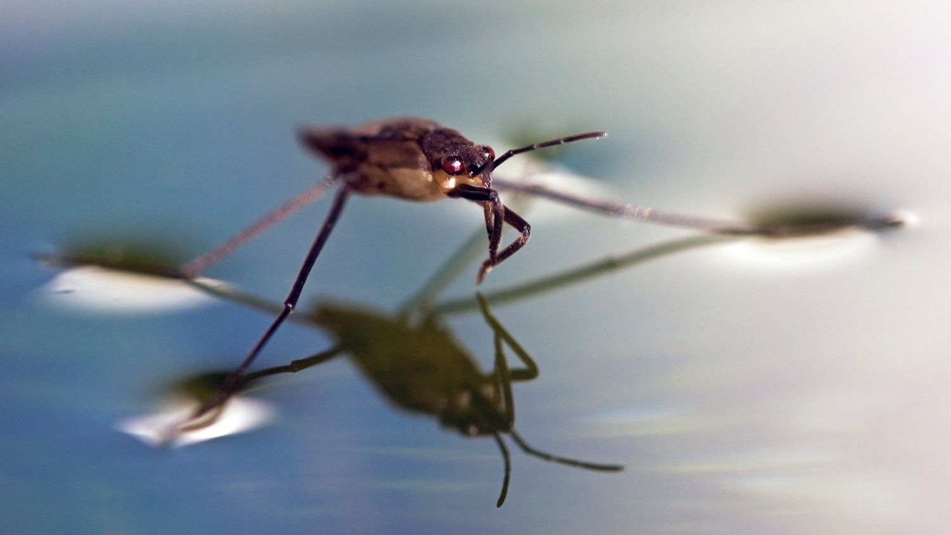
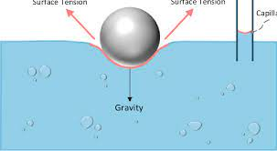
SURFACE TENSION
Video
Surface tension is the film that forms on the surface of a liquid caused by cohesion. Cohesion is the force of attraction between particles (molecules) of a substance.

Slide 20
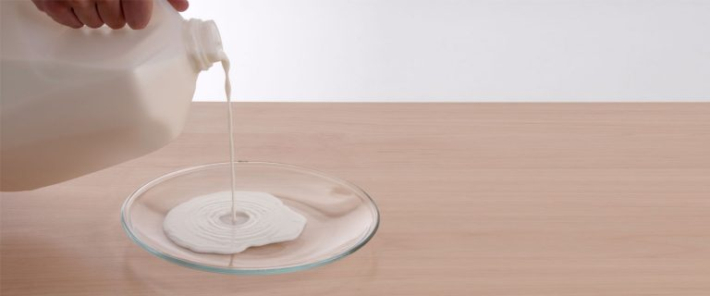
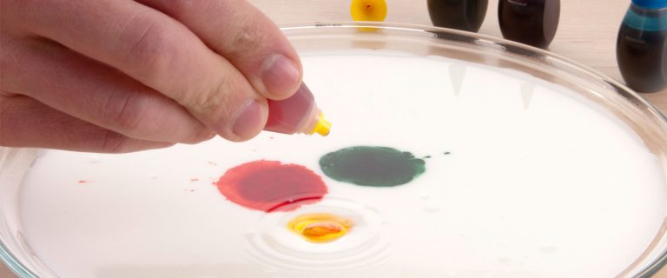

Milk RAINBOW Demonstration

Slide 21
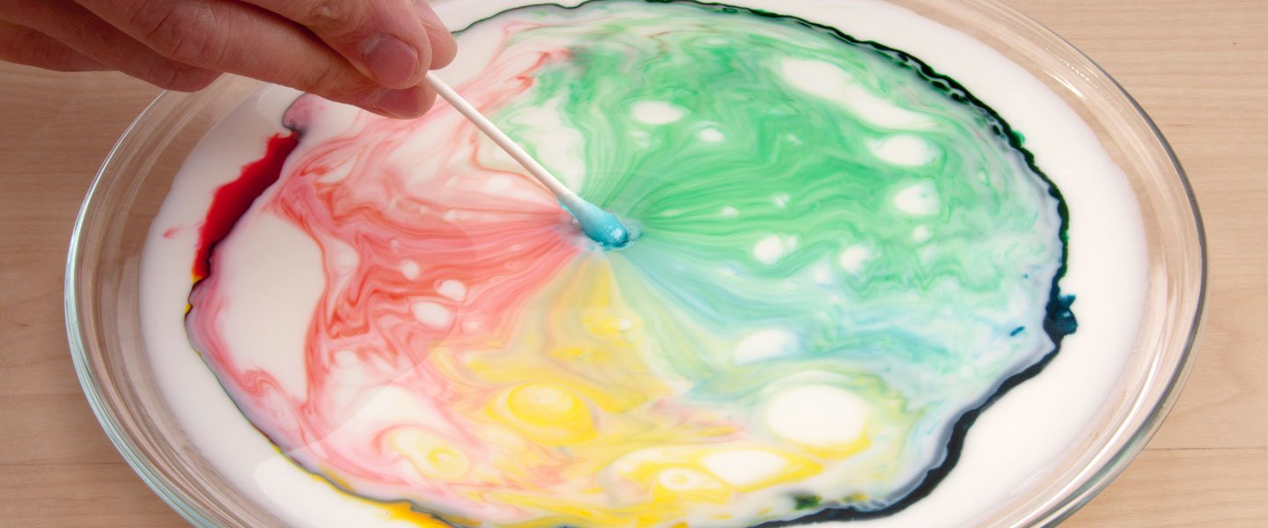
EXPLANATION
When liquid dish soap is added to milk with drops of food coloring on the surface, the soap reduces the surface tension of the milk and reacts with the fat. This interaction causes the fat particles in the milk to move and create swirls of color.

Slide 22
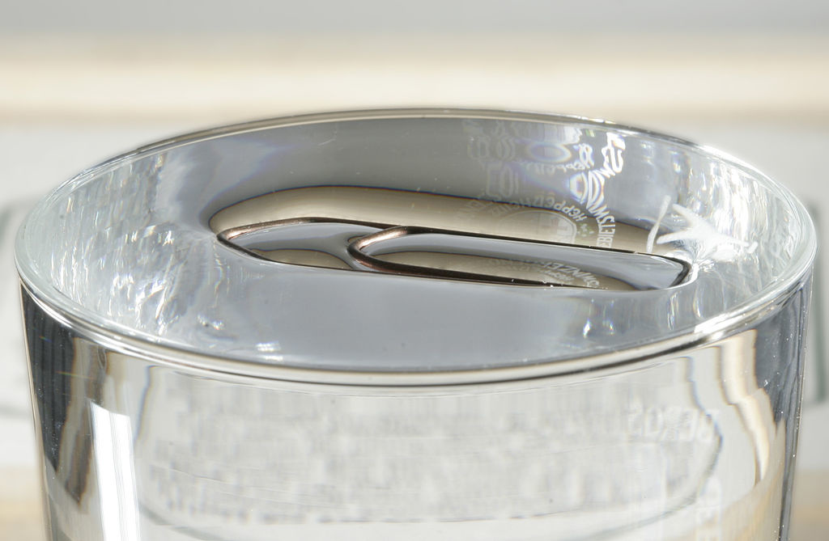
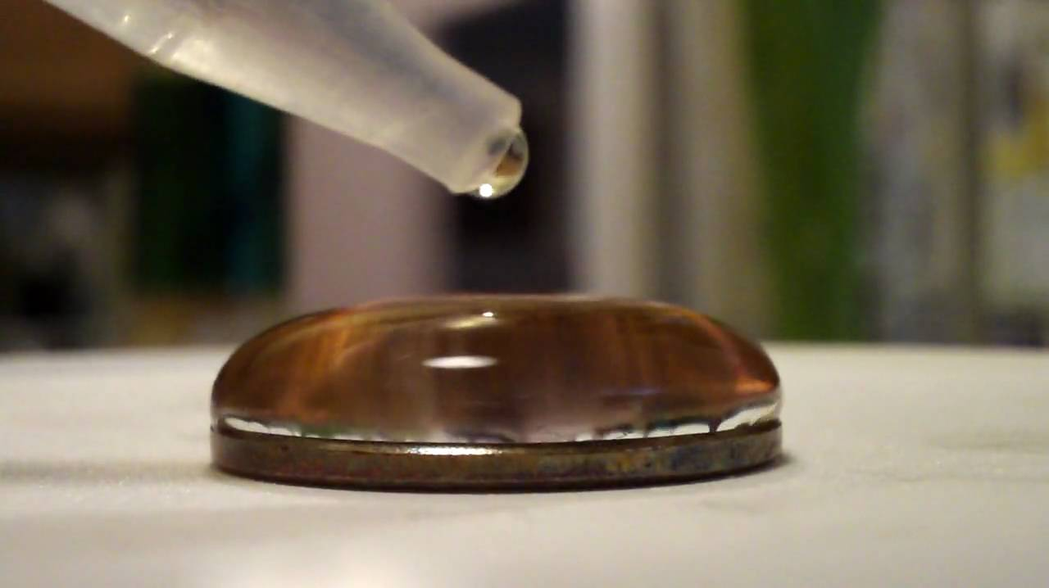
LAB
Paperclip experiment steps:
Fill cup with water
Place paperclip
Observe
Penny experiment steps:
Wash and dry penny
Fill pipette with water
Drop individual drops of water onto penny
Keep track of the water drops as you add them, one at a time, until water runs over the edge of the penny.

Slide 23
Day 5: MASS, DENSITY, & VOLUME

Slide 24
WHAT IS VOLUME, MASS, AND DENSITY?
Volume is the quantity of three-dimensional space occupied by a liquid, solid, or gas.
Mass is the amount of matter or substance that makes up an object. Whether you're on the moon or Earth, your mass doesn't change - there's still the same amount of you.
Density is a measure of how compact the mass in a substance or object is.

Slide 25
VIDEOS
VIDEO
https://www.youtube.com/watch?v=if2aH9OKZLU
https://www.youtube.com/watch?v=GnBQ6vIutDM
https://www.youtube.com/watch?v=74jU3B-2bAE

Slide 26
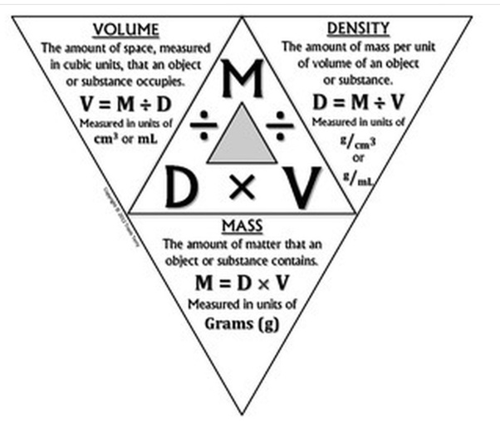
MASS & VOLUME WORKSHEET

Slide 27
Day 6: DENSITY AND FLOATING LIQUIDS

Slide 28
Density and floating liquids
What do you notice about the rock?
○ A layer is a thickness of a substance that sits on a surface.
Multiple layers can sit on top of one another.
➢ Different liquids can layer on top of one another.
➢ Substances that are less dense will float on top of substances with greater density.
○ This explains why oil floats on water

Slide 29
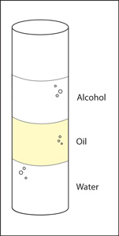
LECTURE
The density of a liquid determines whether it will float on or sink in another liquid. A liquid will float if it is less dense than the liquid it is placed in. A liquid will sink if it is denser than the liquid it is placed in.
The density of a liquid is a measure of how heavy it is for the amount measured. If you weigh equal amounts or volumes of two different liquids, the liquid that weighs more is denser. If a liquid that is less dense than water is gently added to the surface of the water, it will float on the water.

Slide 30
WILL IT SINK OR FLOAT?
Popsicle Stick S/F
Metal Penny S/F
Plastic Spoon S/F
Metal Spoon S/F

Slide 31

LAYERING LIQUIDS LAB
Honey, corn syrup. Dish soap, water, vegetable oil, rubbing alcohol,

Slide 32
Day 7: MIXTURES AND SOLUTIONS

Slide 33
WHAT ARE THEY?
Mixture: When two or more kinds of matter are put together.
○ Mixtures can be made with solids, liquids or gases. Any combination of two or more substances will result in a mixture.
Solution: A mixture where the substances are spread out evenly and can no longer be told apart with the physical eye, also called homogeneous
○ Example: When a solid is dissolved in a liquid, we call the liquid a solvent and the solid is called the solute.
Video

Slide 34
Can you separate it?
Can you separate out the parts of a mixture or solution?
○ You can do this by filtering, actually pick out and separate, or you can even change the phase of matter (liquid, solid, gas)
○ Example: picking out and separating the different fruits in a fruit salad or evaporating water from a saltwater solution.

Slide 35
IS THIS A MIXTURE OR A SOLUTION?
SALT AND WATER SOLUTION/MIXTURE
OIL AND WATER SOLUTION/MIXTURE
TRAIL MIX SOLUTION/MIXTURE
MIXED CEREALS SOLUTION/MIXTURE

Slide 36
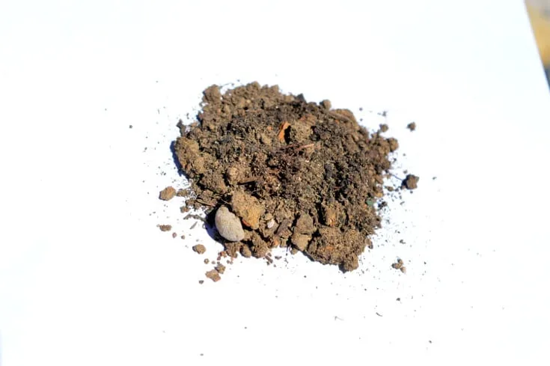
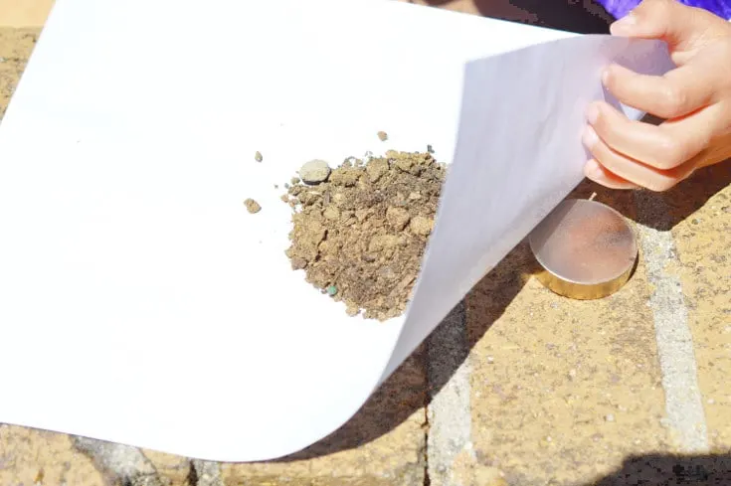
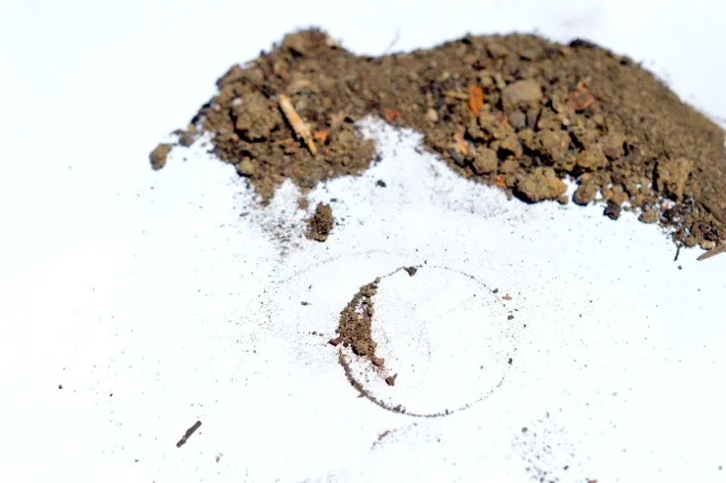
LAB - MESSING WITH MIXTURES
Have you ever wondered where metals such as iron, copper or nickel come from?
Turns out a lot of metals can simply be found in soil.
Steps:
Put soil on a paper plate.
Place the magnet underneath the soil and the paper plate
Move the magnet around and see what happens
As you move the magnet around, some of the soil will move with it. If there is enough magnetic soil, you can see the pieces align with the magnetic field of the magnet.

Slide 37
RECAP
Today we learned the difference between a mixture and a solution
We learned different ways we can separate a mixture or a solution

Slide 38
Day 8: ACIDS and BASES

Slide 39
What is an Acid, what is a BASE
Acid: An acid is a substance that has a lot hydrogen ions (H+)
acidic solution donates hydrogen ions (or accepts electron pairs).
Base: A base is a substance that has a lot of hydroxide ions (OH-)
A basic solution accepts hydrogen ions (or donates electron pairs as hydroxide ions)

Slide 40
WHAT IS ph?
pH: Think of the pH scale as a ruler that we can use to measure how acidic or basic something is.
To tell if something is an acid or a base, you can use a chemical called an indicator.
An indicator changes color when it encounters an acid or base.
video

Slide 41
LAB TIME: ACID, BASE, and COLOR CHANGE
Using a red cabbage indicator solution, students will indicate which solutions are acidic and basic

Slide 42
Day 9: POTENTIAL AND KINETIC ENERGY

Slide 43
WHAT IS POTENTIAL AND KINETIC ENERGY?
Potential energy is the stored energy an object has because of its position or state. A bicycle on top of a hill, a book held over your head, and a stretched spring all have potential energy.
Kinetic energy is the energy an object has due to its motion. As long as an object is moving at the same velocity, it will maintain the same kinetic energy. The kinetic energy of an object is calculated from the velocity and the mass of the object.

Slide 44
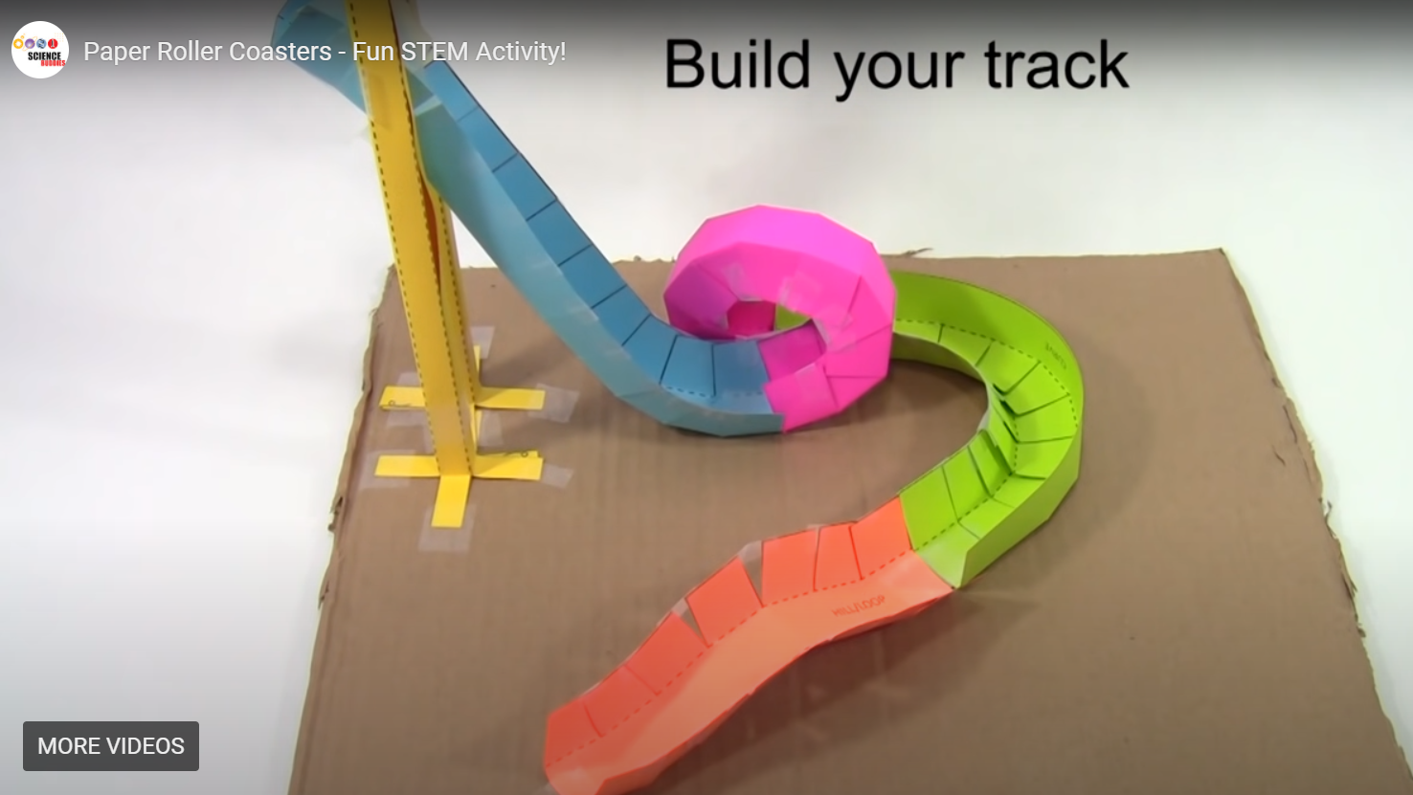
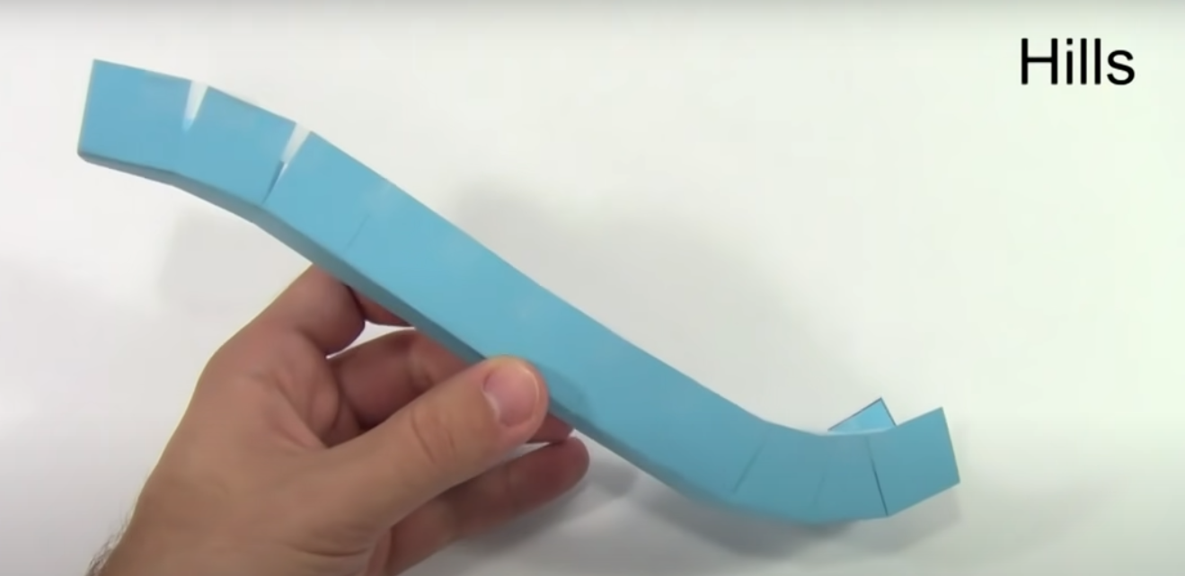
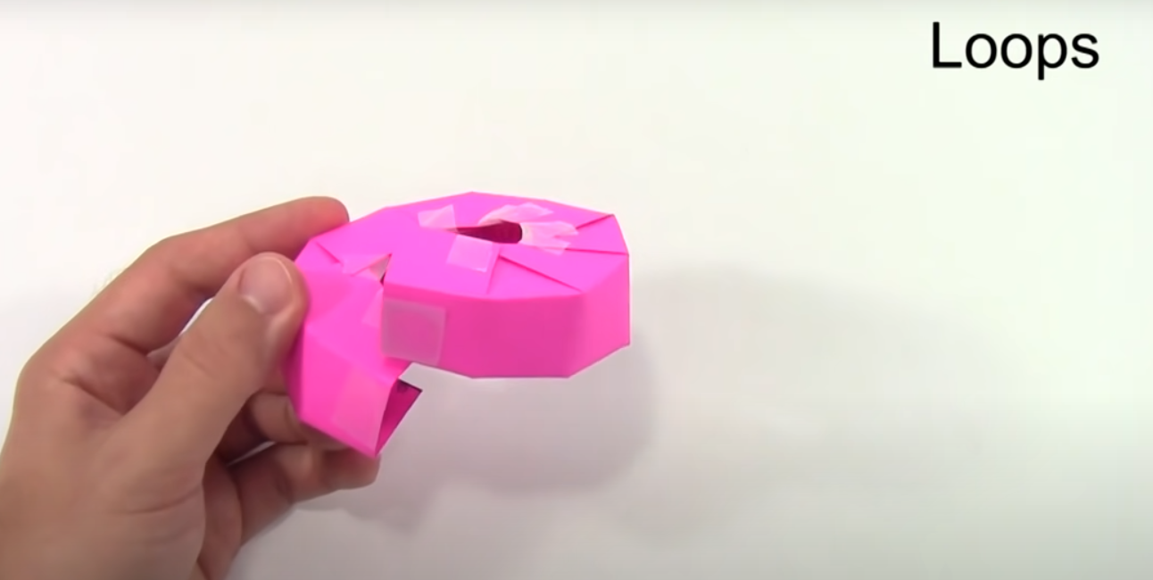
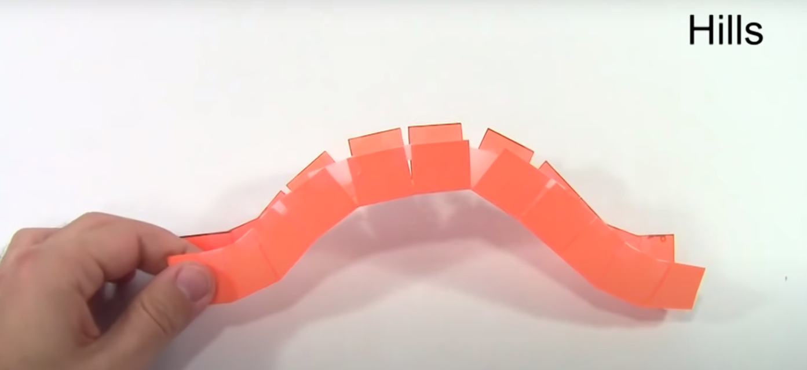
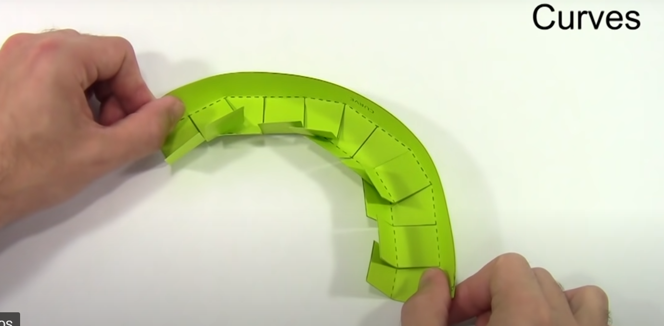
PAPER ROLLER COASTER
What goes up, must come down. How much energy does a roller coaster car need to make it through a loop? In this lesson, students will learn about kinetic and potential energy as they build their own roller coasters from simple classroom materials.

